Slide 1
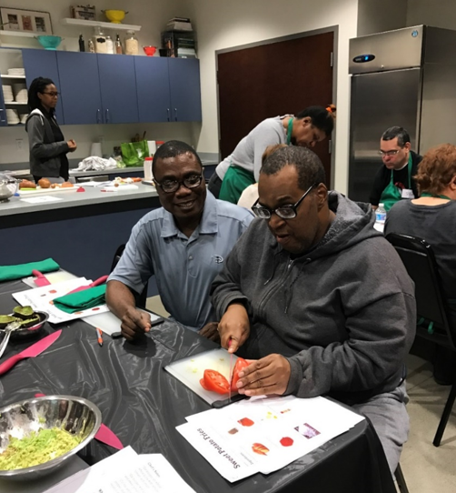
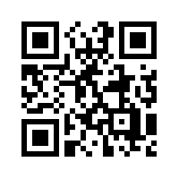
Engaging Disability Provider Organizations in Development of an Inclusive Wellness Program
Ann C. Robinson, BS¹, Jesse G. Strickler, BA¹, Donna E. Green, BA¹, Melinda DelFratte², Tammy Mackey, MSed³, Boo Krucky⁴
¹Nisonger Center, UCEDD, ²Boundless, ³ARC Industries North, ⁴Goodwill Columbus
The Need to Support Direct Support Professionals (DSPs)
Engagement of community partners and DSPs in this work was essential.
By connecting with state and community partners to help distribute a needs assessment of current wellness offerings, interests, and perceived barriers, we heard directly from professionals around Ohio who could help define our strategy. Leadership and staff at local provider organizations were willing to pilot programs with their staff and service recipients, give us honest feedback about the feasibility of program elements as designed, and offer suggestions based on past experience.
We could not expect to design a program for this group of professionals that did not recognize the role they have as a caregiver and to include these perspectives as the driving force in trying to increase health opportunities for both them and the people they serve.
Creation of an Inclusive Wellness Program Framework
DSPs experience job-related stress, insufficient wages, and feelings of being undervalued. (Ejaz, Bukach, Dawson, Gitter, & Judge, 2015)
Disability provider organizations face significant issues with recruitment and retention of staff. (Hewitt & Larson, 2007) Staff turnover at disability provider agencies can be disruptive to managers, other staff, and most importantly, the adults with disabilities for whom they care.
DSPs show deficits in consumption of healthy foods and physical activity, increased use of tobacco products, and higher rates of chronic disease than the general population. (Leser, Pirie, Ferketich, Havercamp, & Wewers, 2017; Marks, Sisirak, Chang, & Murphy, 2019)
The Leading Toward Health (LTH) program is an effort to improve the health of direct support professionals (DSPs) through workplace wellness with consideration of the demands of the caregiving role and the importance of culture within organizations struggling to retain staff.
Steps taken in development of the LTH framework:
The Ohio Disability and Health Program (ODHP) distributed a wellness needs assessment to provider organizations around Ohio. Leadership and staff from 38 disability provider organizations submitted responses that identified the strengths and weaknesses of current wellness offerings, opportunities for leadership to implement new policies and programs, and the feasibility of proposed activities. These results established areas of focus for the program as nutrition education, opportunities for physical activity, and training in stress management techniques.
Many DSPs do not participate in workplace health activities due to time constraints and/or caregiving functions on the job. They may feel that taking time for themselves instead of simply assisting is inappropriate or will impede their perceived job performance.
A literature review of evidence-based practice in the areas of physical activity, nutrition, and stress management was conducted. From this review, recommendations were developed for types of programs that could be utilized by both adults with disabilities and DSPs at the workplace.
Considerations for this Program
Workplace wellness programs have been found to increase perceived social support, job satisfaction, and healthy behaviors in employees. (Song & Baicker, 2019).
While evidence-based programs that are inclusive of the needs of people with disabilities wellness exist, they can be overly restrictive for many workplaces. Diversity in structure, scheduling, or employee health literacy levels, as is typically found at disability provider organizations, can be barriers to implementing wellness programs.
Support from organizational leadership is a key component in employee participation and for sustainability of programs. Planned program elements should provide ways to reach participants through individual, interpersonal, and organizational level actions.
Individuals at varying stages of health behavior change can be targeted. Using a multimodal and multilevel approach to wellness programming means that there is potential for individual movement between these stages and that people are provided direction when they are ready to engage more fully in making healthy changes for themselves.
Representatives from three local provider organizations invited ODHP team members to participate in wellness classes at their organization and speak with staff about their interests and preferences for wellness at work.
A framework for the program was then drafted. The Leading Toward Health wellness framework is broken into three strategic action domains of organizational culture: Organizational Support, Program Activities, and Environmental Supports. Program elements in the each of these domains are to be chosen by leadership and key staff at the site level in order to align with workplace structure and DSP preferences.
An advisory committee made up of self-advocates, disability professionals and community partners then reviewed the guide and provided additional recommendations.
Funded by the Centers for Disease Control and Prevention Cooperative Agreement Number 5U59DD000931-02. Contents are solely the responsibility of the authors and do not necessarily represent the official views of the CDC.

